Slide 1

Week 9 Applications and Implications of Blockchain (Part I1: Risks)
MM1031 Introduction to Innovation and Entrepreneurship
Dr. Edmond Yeung
Department of Management and Marketing

Slide 2
Agenda
Case: Metaverse and Virtual Real Estate
Video: Blockchain’s risks
Assignments: Forum and Final

Slide 3
Case
Metaverse and Virtual Real estate

Slide 4
Background: metaverse
The metaverse is attractive to players across the globe:
who can visit different locations,
see their favorite musical artists perform,
or lease a space to sell their own NFTs or other virtual products without the constraints and limitations of the physical world
https://sandboxgame.gitbook.io/the-sandbox/
https://decentraland.org/
https://www.youtube.com/watch?v=p6fr0UFhLjA&ab_channel=ForbesDigitalAssets
Advocates day it’ll soon develop into a fully functioning economy that’s integrated into our daily lives

Slide 5
What is Virtual Real estate
The metaverse has been steadily establishing digital domain in real estate as a kind of virtual world game. In the metaverse, cryptocurrency from digital wallets is used to purchase virtual land via a blockchain ledger.
https://www.reuters.com/markets/currencies/virtual-real-estate-plot-sells-record-24-million-2021-11-23/
https://shkco.sandbox.game/?_gl=1*1e2boio*_ga*MTA4MTg4OTMxNi4xNjY2NDM5MjEy*_ga_R0TLSXCC02*MTY2NjQzOTIxMi4xLjEuMTY2NjQ0MDM2OS4wLjAuMA..

Slide 6
Prices for virtual land plots…
have increased drastically in the past few years, soaring after Facebook announced its pivot to virtual reality and its rebranding as Meta.
https://www.forbes.com/sites/ronshevlin/2022/02/04/digital-land-grab-metaverse-real-estate-prices-rose-700-in-2021/?sh=13a22d3c7cdc
https://www.cnbc.com/2022/01/12/investors-are-paying-millions-for-virtual-land-in-the-metaverse.html
https://www.yahoo.com/now/three-plots-digital-land-next-163550699.html?guccounter=1&guce_referrer=aHR0cHM6Ly93d3cuZ29vZ2xlLmNvbS8&guce_referrer_sig=AQAAAJqEVPNpU9hqFD-Mfu8Mvj_6keAlMShL6oqqKwzyhRbAa7Myfh-R7eRDx5i2DD4SS0qQf99BMw1NYCJZZAez1DdDFltt90SdksQGbsEO-FSHJV42d-9lyqkb5rYtr96vrsQShUzIiQcWwCXvbOCgaeyKJMIaZ1Ly7XWiQSChKROv
https://vrscout.com/news/snoop-doggs-new-music-video-was-shot-in-the-metaverse/
https://www.sandbox.game/en/snoopdogg/

Slide 7
Potentials of Virtual real estate & Metaverse
Gaming
Entertainment
Social activities
Art and Collectables
Marketing
Sales and Retail
Convention and Exhibition
Education
https://crowdcreate.us/top-companies-building-in-the-metaverse/

Slide 8
Risks of the virtual real estate
Speculative buying
Digital currencies required to purchase virtual land, which have been rife with volatile jumps and drops in value
“Pump and dump” schemes
https://www.cnbc.com/2022/01/12/kim-kardashian-and-floyd-mayweather-sued-over-alleged-crypto-scam.html
Outright (Completely) fraud
https://www.coindesk.com/business/2022/02/11/seven-crypto-exchange-executives-handed-prison-sentences-for-18b-fraud-in-south-korea-report/

Slide 9
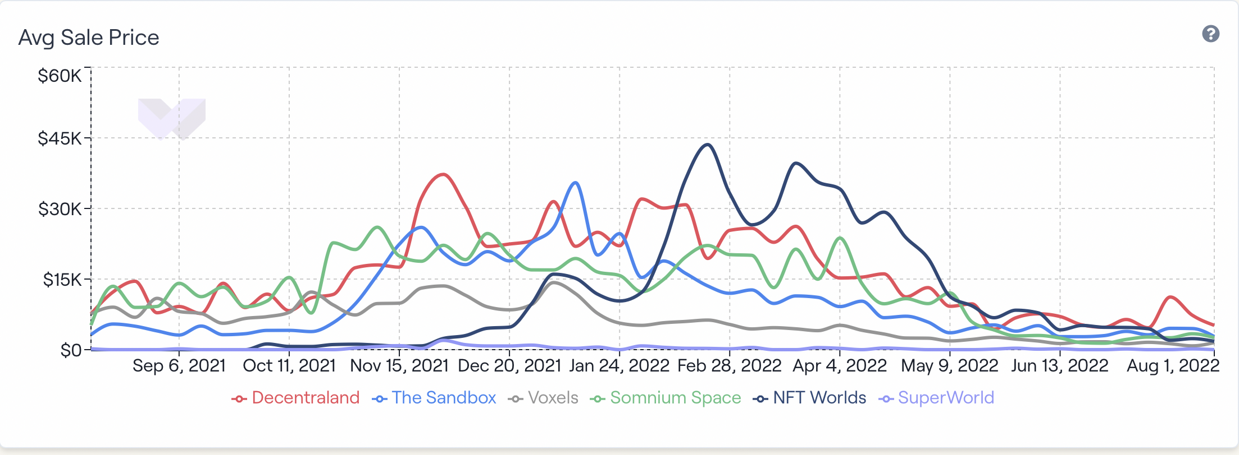
The Virtual RE bubble is pop??
https://cointelegraph.com/news/metaverse-housing-bubble-bursting-virtual-land-prices-crash-85-amid-waning-interest

Slide 10
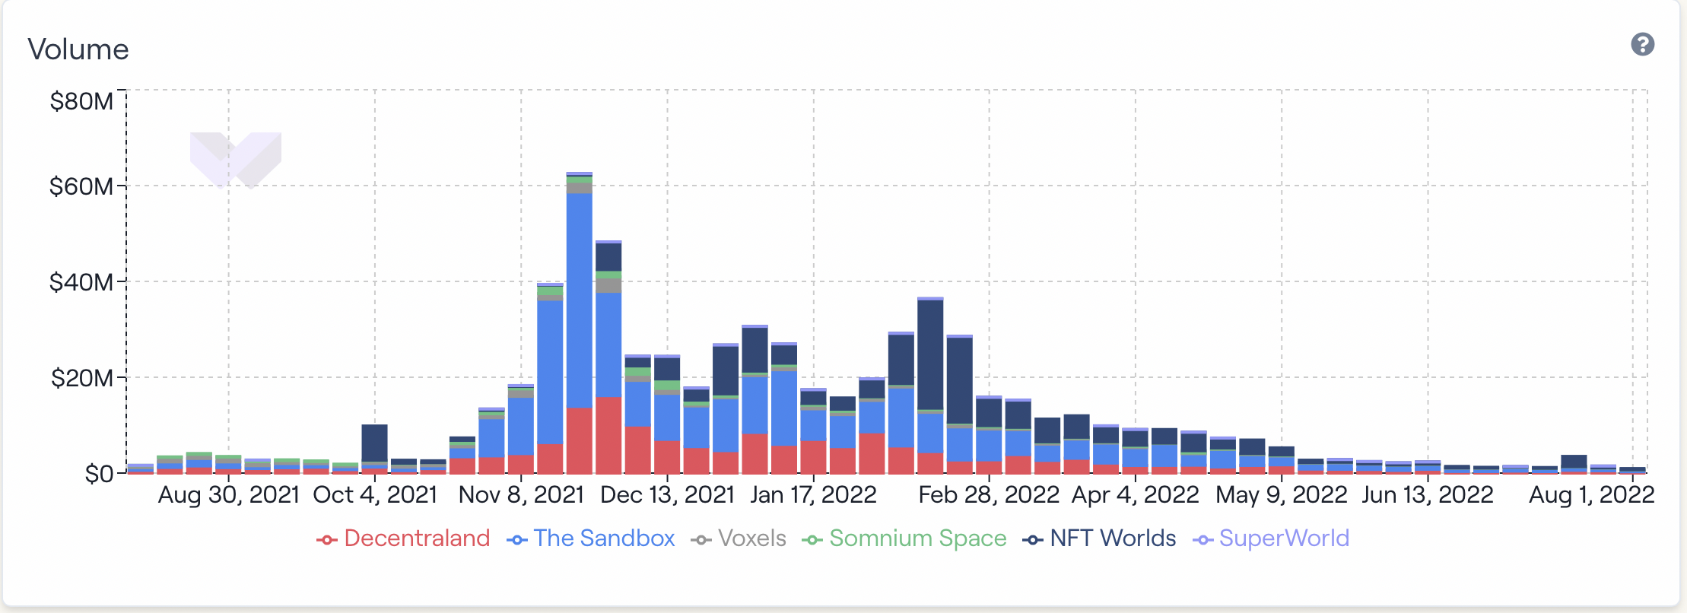
The Virtual RE bubble is pop??

Slide 11
Do you consider…..
The virtual land and metaverse boom is done?
Investment in the metaverse and in digital assets will bounce back?
Notes:
Risk: Unstable Crypto, speculation

Slide 12
Is virtual real estate & Metaverse……
a bubble ready to pop / has already pop??
a short-term bubble that will give way to a long-term trend

Slide 13
Video
Blockchain Risks

Slide 14
In the Week 9 Folders
Video: Blockchain Risks
Case: Virtual Real Estate
Forum 5 (10% of subject marks)
Final Assignment (60% of subject marks)

Slide 15
Enjoy your self-study Have a nice day!

